Slide 1

Project Proposal Group 3
By Ryan McCormack, Ellyn hernandez, Ronald Lynch

Slide 2

Introduction
The problem: Life expectancy is a very significant pointer in population health and technological development. However, as life expectancy increases as it has recently, the long-term trend is unknown.
Our data analysis research question will be: What will be the life expectancy of the global population be by 2050?
Through recent technologies and medicines, life expectancy has increased over the last several decades, and this can influence healthcare services, social services and retirement programs
This is important as governments and companies have to prepare for the future and for aging populations, such as for pensions, medical care, elderly care etc.

Slide 3
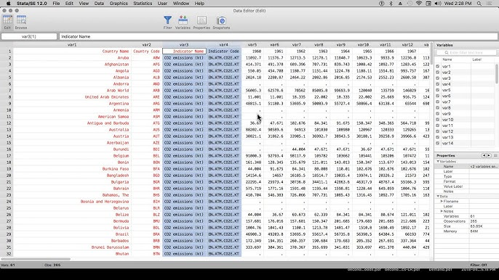
Dataset
We will be using the data set from World Bank ”Life expectancy at birth, total (years)” which includes: https://data.worldbank.org/indicator/SP.DYN.LE00.IN (This link, download the csv)
Life expectancy at birth – measures the average a newborn is expected to live
Country name – displays country name
Country code – displays country code
Year – Year corresponding to life expectancy
This dataset provides data from 266 countries and their life expectancy every year from the 1960s-2023.

Slide 4

Answering research questions
Our analysis will primarily use power BI for data prep, modeling, and visualization.
Power BI will be used to clean the data if needed and to organize the dataset. We will also reformat the data into more of a time-series format so we can examine how the data changes over time
Power BI has a built-in forecasting feature that can also be used to project life expectancy through a certain date through historical patterns in the data, as well as interactive charts which can help clearly show trends and uncertainties in the predictions for the viewer
Power BI KPI cards will be used to show key summary information such as current global life expectancy, projected life expectancy in 2050, and overall growth since 1960.

Slide 5
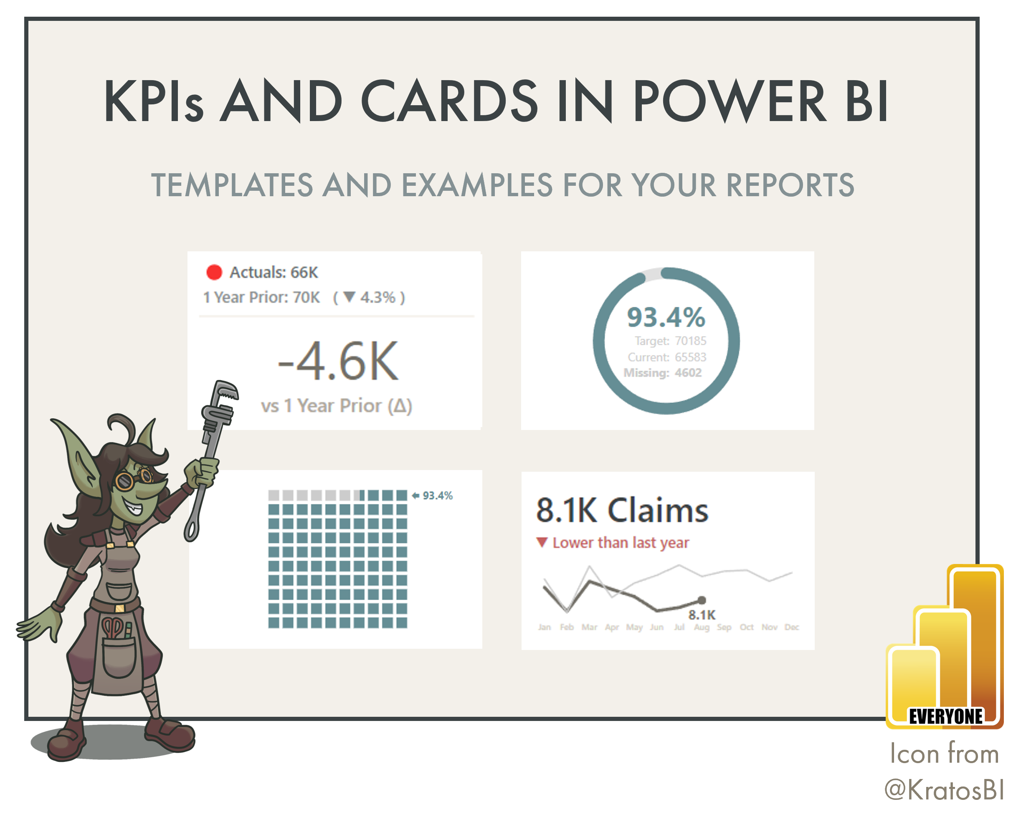
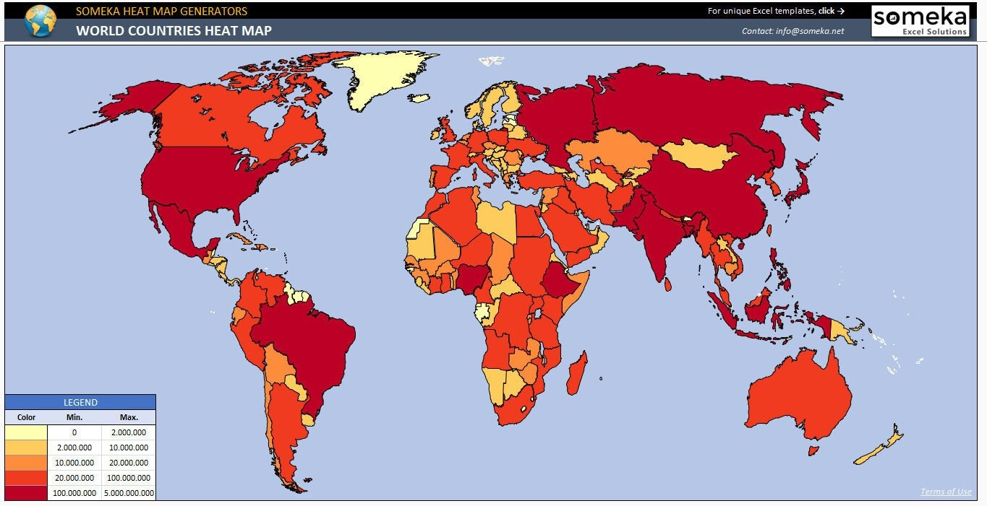
Visualizations
The visualizations we plan to use are trend analysis and KPI cards, as well as a decade comparison chart
The trend analysis will be a line chart that shows the life expectancy throughout the years until currently, and will predict until 2050 using confidence intervals
We will use KPI cards in order to recap the most important information which is the average life expectancy leading to 2025, total growth since 1960, and projected 2050 values
We will use a decade comparison chart to analyze life expectancy changes across decades which will help us identify growth patterns as well as the shifts through time in the improvement rate
Heat map used to show difference in growth patterns across continents

Slide 6
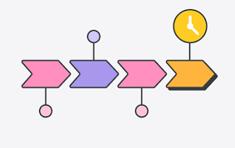
Timeline
The first week will be setting up the data for analysis with each member doing their own research on global life expectancy and reviewing the dataset
The second week will be dedicated to finishing up cleaning the data if necessary
The third week will be focusing on creating the charts and KPI cards, each member working on either the trend analysis chart, KPI cards, or decade comparison chart. This will take us around 2-3 weeks
The final week we will be wrapping up anything that is not done yet or needs improvement

Slide 7

Any questions?

